Slide 1
File importer system design

Slide 2
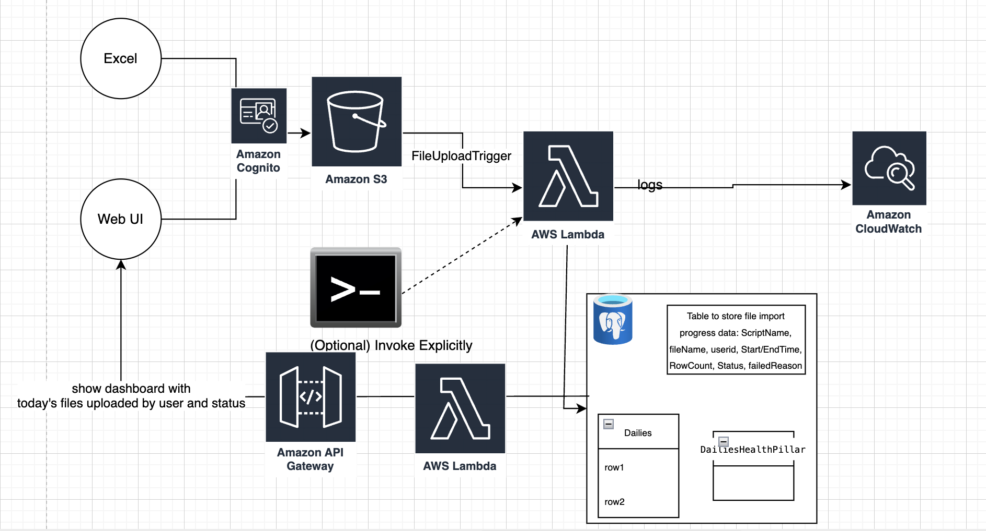
Proposed design

Slide 3
Pros
No servers to maintain.
High scalability and bursts of requests
Low cost - Pay only when you use
Secure with IAM
No additional background jobs are required.
No additional step to convert files to CSV because these files are discarded anyways.
Faster deployment

Slide 4
Limitations
Limited memory - 10 GB but current file sizes are very low(400 KB) so it would process easily. User creating large excel files doesn’t seem to be practical.
Limited disk space(10 GB) - again this isn’t a problem due to low file size.
Limited execution time - 15 mins - Small files are easily processed.
Complexity in local testing - AWS SAM can be used.
Cold start up time - As it is a background process, there shouldn’t be an impact.

Slide 5
Further improvements
Add notification email to user once all the uploaded files are processed.
Store credentials in secrets to allow lambda to fetch them directly.
Add local tests
Each log line to include timestamp, filename and scriptname

